Slide 1


Slide 2


Slide 3




The University of Lahore
Department of CS & IT
Project ID: Fall-2023-51 Session: BSCS Fall 2020 to 2024

Slide 4

Eatonomy
MODERNIZED FOOD AND RESTAURANT RECOMMENDATIONS
Presented by, Muhammad Ali 70109014
Haider Ali 70069779

Slide 5
Table of contents
Introduction
Existing Solutions and limitations
Functional Requirements
Use Case Diagram
Methodologies Used
Applications and Tools Used
Technologies Used
Project Demonstration
Lessons Learned
Future Work
Conclusion

Slide 6

1. Introduction
Brief Overview
Problem Statement
Objectives

Slide 7
1. Introduction (Continues)
Brief Overview
This app is designed to provide personalized food suggestions based on the user's preferences
This app aims to save users time while deciding what to order
To try and make the user follow a healthy diet based on suggestions

Slide 8
1. Introduction (Continues)
Problem Statement
Existing food ordering platforms are limited in suggesting food recommendations
Users waste a lot of valuable productive time in deciding what to order
Users are shown sponsored content which may not align with that the user needs

Slide 9
1. Introduction (Continues)
Objectives
Provide users with a healthy food menu
Save users precious time by aiding in decisions
Increase satisfaction by catering to the users needs

Slide 10
2. Existing Solutions and limitations
Uber Eats:
Offers food delivery
Does not offer to provide user with personalized recommendations
Limited service area

Slide 11
2. Existing Solutions and limitations
Cheetay, Eat Mubarak and Food panda:
Offer food delivery
Do not offer to provide user with personalized recommendations
Do not advise the user about healthy meal plan
Basic UI which leads to average UX

Slide 12
2. Existing Solutions and limitations
Proposed solution (Eatonomy):
Offer food deliver
Efficient Decision Making
Improved Dietary Management
Enhanced User Engagement

Slide 13
3. Functional Requirements
User Account:
Eatonomy Hub:
Cart:
Create Account
Login Account
Forget Password
Add address
Modify Address
Profile Page
Edit Profile
Logout
Food preferences
Home Page
View Restaurants
Popular Items
Search for food and restaurants
Save food item to favorite food
Save restaurant to favorite restaurant
Order History
View Cart
Add Items to Cart
Remove Items from Cart
Place Order

Slide 14
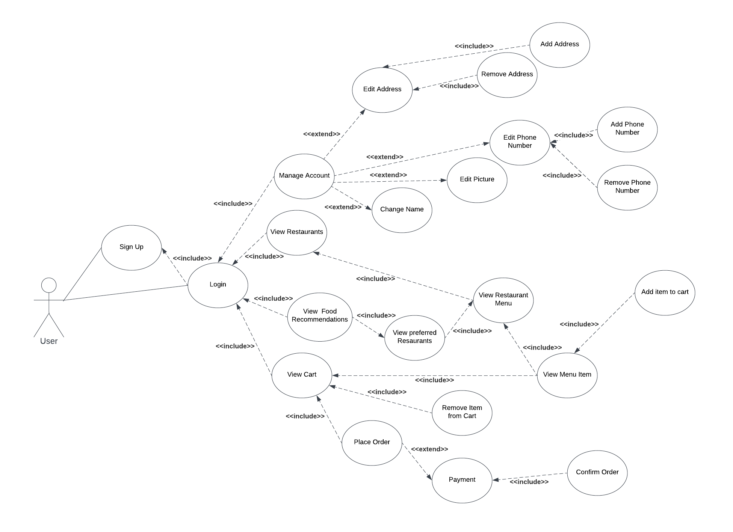
4. Use Case Diagram

Slide 15
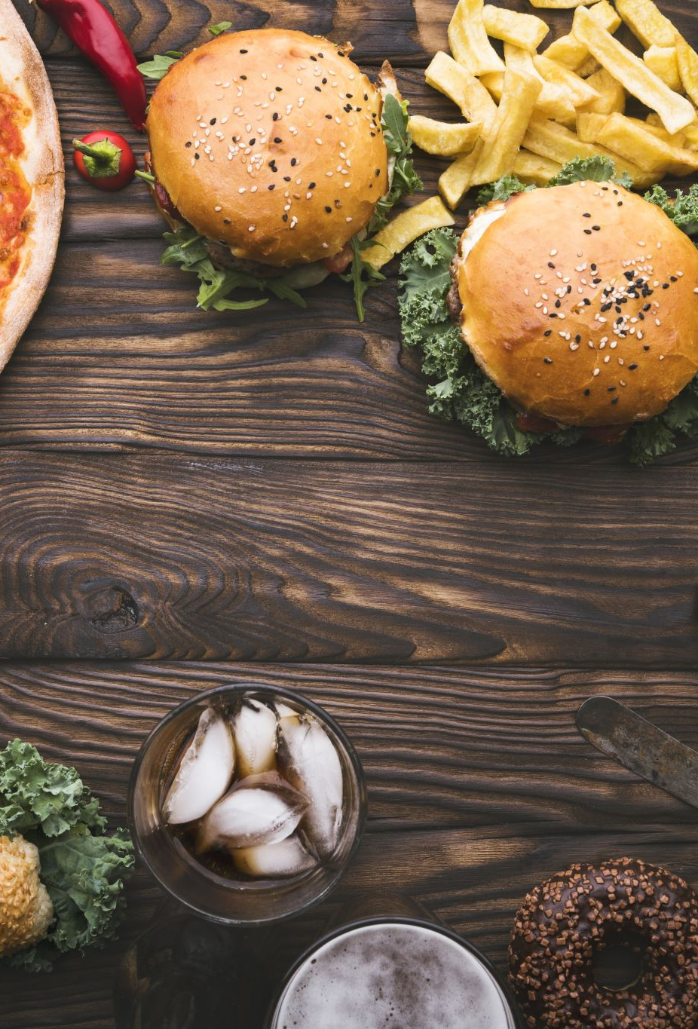
5. Key Features
Recommending food based on the user's mood
Getting recommendations based on users' history
Optimizing the decision process of ordering food

Slide 16

5. Methodologies Used
Agile Development: Iterative and incremental development
Requirements Gathering: Conducted interviews & analyzed the needs
System Design: Outlined system components and interactions
Development: Coded the project for cross platform capability
Testing: Evaluated the different functionalities
Deployment: Made the app work without any issues on iOS and Android
Maintenance: Hot patches and updates are scheduled for any bug found

Slide 17

6. Applications and Tools Used
Android Studio: The official IDE for Android development. The latest version, Android Studio Koala 2024.1.1, is used for developing and testing.
Google Firestore: To manage the Firebase database.
Xcode: IDE for macOS used for developing iOS applications.
Flutter Flow: A visual development platform used to design the UI
Git: To manage source code versions
Figma: An interface design tool used to create the visual design and layout of the app.
Provider: State management library for managing app state.
Shared preferences: Used for storing simple data persistently.

Slide 18

7. Technologies Used
Dart: Used with Flutter for cross-platform mobile application development.
Swift: Employed for iOS-specific functionalities.
Kotlin: Used for Android-specific functionalities.
NoSQL: Utilized in Firebase for database management.

Slide 19
Time For Demonstration

Slide 20
9. Project Demonstration
User Account Sign up
Login Account
Food preferences selection
Browsing home page
Adding food items to favorites
Adding restaurant to favorites
Adding items to cart
Removing Items from cart
Confirming address
Placing order
Viewing placed orders
Editing profile
Logout

Slide 21

10. Lessons Learned
Comprehensive Requirements Gathering
Team Collaboration
Designing with Figma
Testing and Reliability
Learning and Using Flutter Flow
Cross-Platform Development with Xcode and Swift
Understanding and Implementing MVVM Architecture
Data Structure Concepts
Database Query Optimization

Slide 22

11. Future Work
Advanced Analytics and Tracking Tools
Robust Security Measures
Using a web scrapper to properly fetch existing data
Leveraging AI and Machine Learning
APIs for third-party Integrations
Comprehensive Admin Panel
Restaurant Owner application
User Activity Tracking
Advanced User Interaction Features

Slide 23

12. Conclusion
Summary
Impact

Slide 24
12. Conclusion (Continues)
Summary
People are frequently using online applications for ordering food
There are situations in which it is harder to accommodate every persons needs
The rise in prices has caused more confusion while ordering
People may be unsatisfied by what they choose if they have any regrets
Features of Eatonomy
Technologies and Tools Used
Demonstration of Main Functionalities

Slide 25
12. Conclusion (Continues)
Impact
Improving Dining Experience
Support for Local Businesses
Data-driven Insights
Health and Nutrition Awareness
Economic Impact

Slide 26


Slide 27

Any questions?

